Slide 1


MoRoSus Inventory Software
Inventory_manager.sh
Ross Barretto
Donelle Douglas

Slide 2
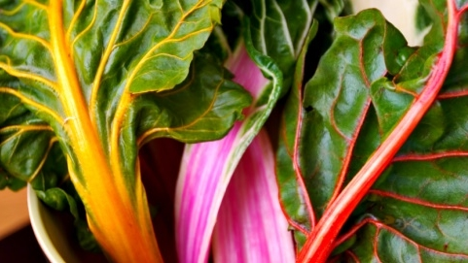


(Customer Scenorio use case)
Local
Fresh
delicious

Slide 3

(Solution)

Slide 4
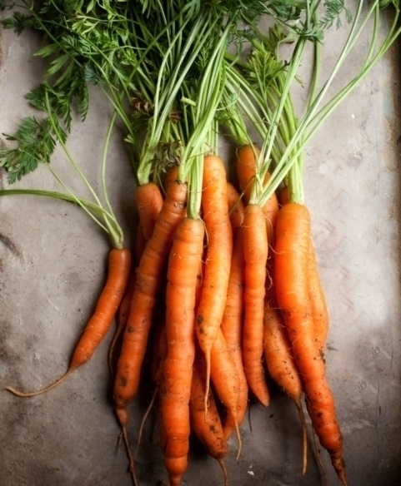
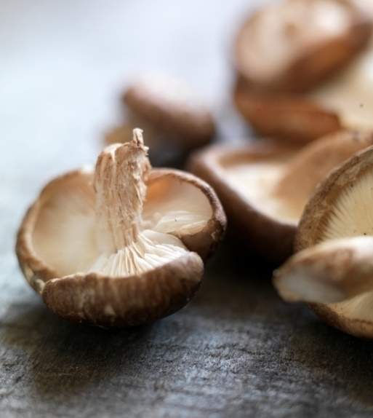

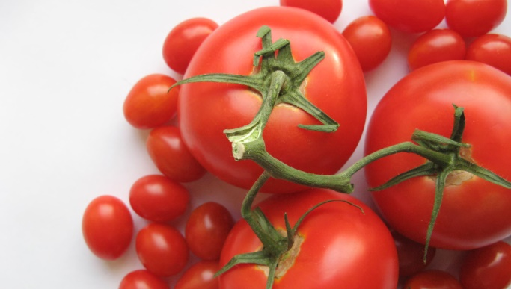
(Arch. User info)
Plant
Grow
Pick

Slide 5
Inventory, adding, Updating, recording Samples

Slide 7
Any Questions? Thank you!

